Slide 1
A Physics-Based Approach to Nonlinear Human Population Growth Modeling
Cole Prather & Chris Fickess

Slide 2
Data Compilation
Using available census data from the USCB, UN, and other sources, a “total” was established and deemed the “canonical” dataset.
This canonical set was compared to known historical events that significantly reduced the population:
Antonine Plague (165 – 180 AD)
Plague of Justinian (500 – 700 AD)
The Bubonic Plague (1350 AD)
Black Death (1350 AD)
Plague of Justinian (541-542 AD)
WWI (1914-1918 AD)
WWII (1939-1945 AD)

Slide 3
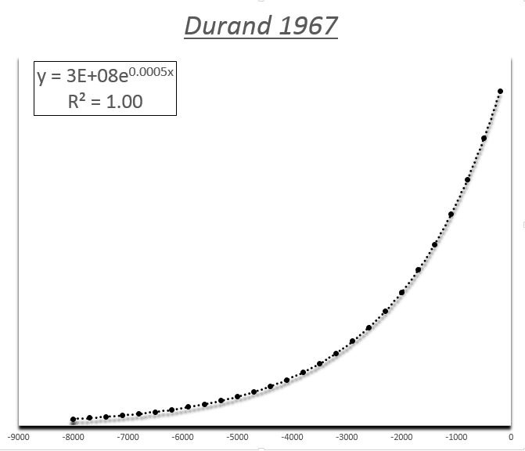
Creating A Population Data Bias
The main issue with creating a bias was finding realistic data.
The Durand 1967 data was a perfect exponential fit, which is impossible.

Slide 4
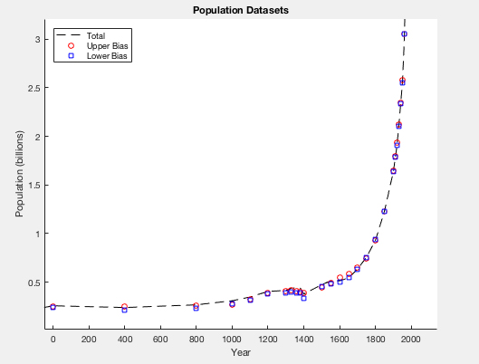
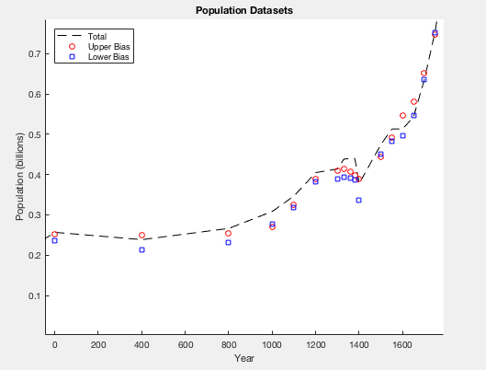
Formation of the Upper and Lower Bias
From the comparison of canonical data to the aforementioned events, some data sets were eliminated accordingly and the remaining were deemed the “bias”.

Slide 5
Models
In order to derive a functional model of the human population over time, the Law of Mass Action and Chemical Kinetics are used to develop a relationship from known models:
Power
Logistic
Exponential

Slide 6
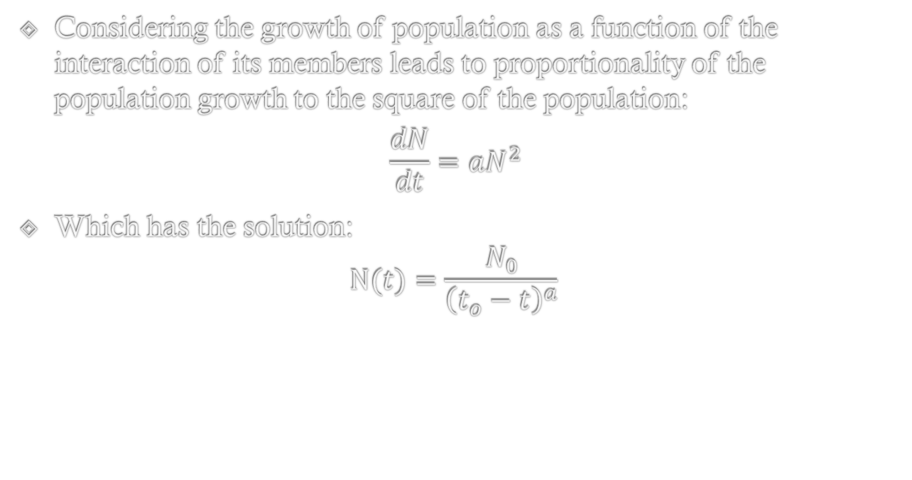
Power Model
Considering the growth of population as a function of the interaction of its members leads to proportionality of the population growth to the square of the population:
$$\frac{dN}{dt}=aN^{2}$$
Which has the solution: $N(t)=\frac{N_{0}}{{\left(t_{o}−t\right)}^{a}}$

Slide 7
Exponential Model
Another known model that represents the population growth as proportional to an exponential function:
$$N\left(t\right)=N_{0}e^{a\left(t−t_{0}\right)}$$

Slide 8
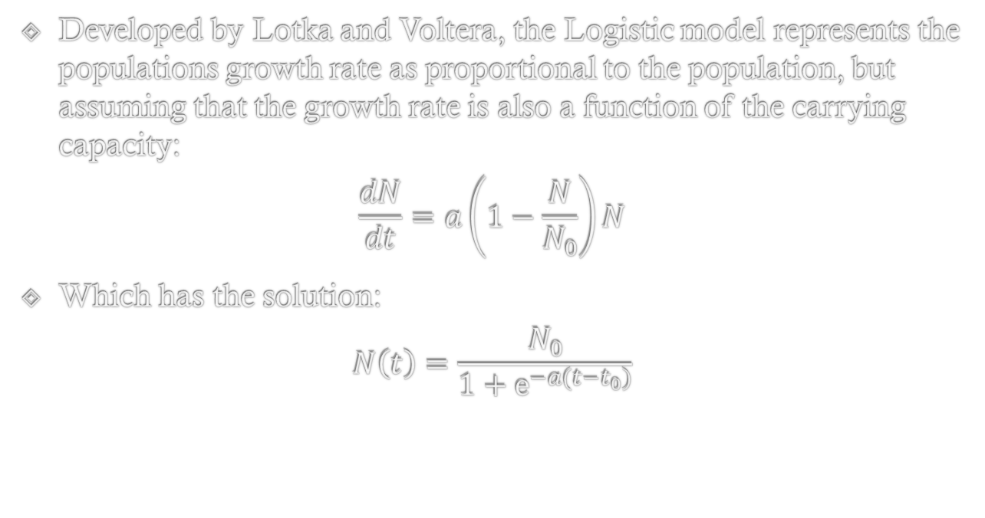
Logistic Model
Developed by Lotka and Voltera, the Logistic model represents the populations growth rate as proportional to the population, but assuming that the growth rate is also a function of the carrying capacity:
$$\frac{dN}{dt}=a\left(1−\frac{N}{N_{0}}\right)N$$
Which has the solution:
$$N\left(t\right)=\frac{N_{0}}{1+e^{−a(t−t_{0})}}$$

Slide 9
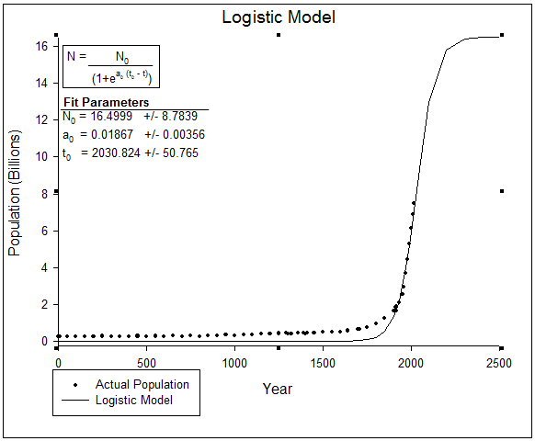
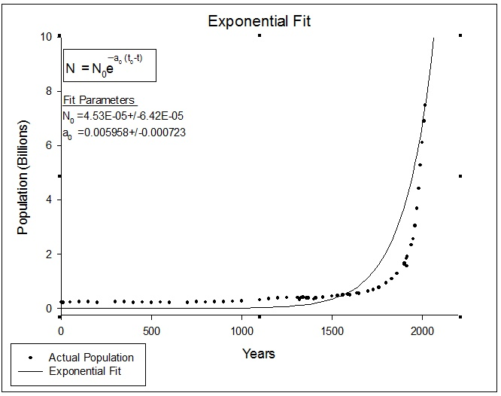
Exponential Vs. Logistic

Slide 10
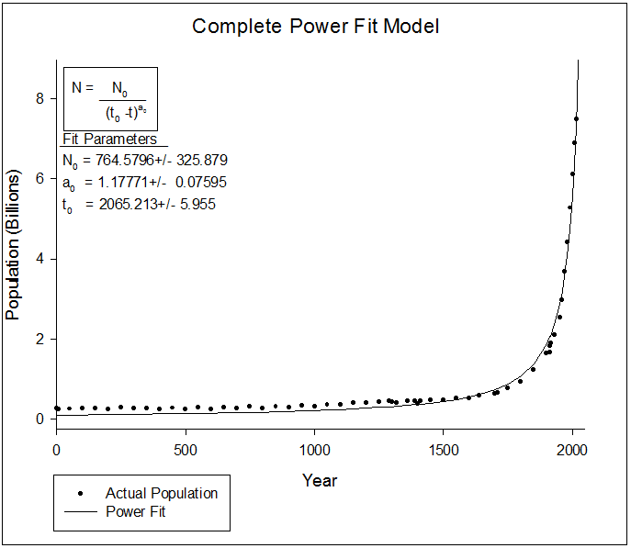
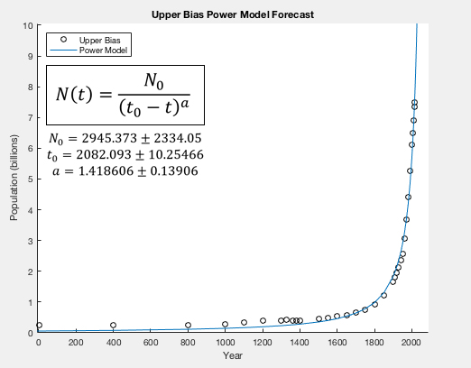
Power Model Comparison

Slide 11
Transition/Extinction Models
The Power, Logistic, and Exponential models of the population were then compared to other models:
Stabilization
Lambda
Dielectric
Extinction

Slide 12
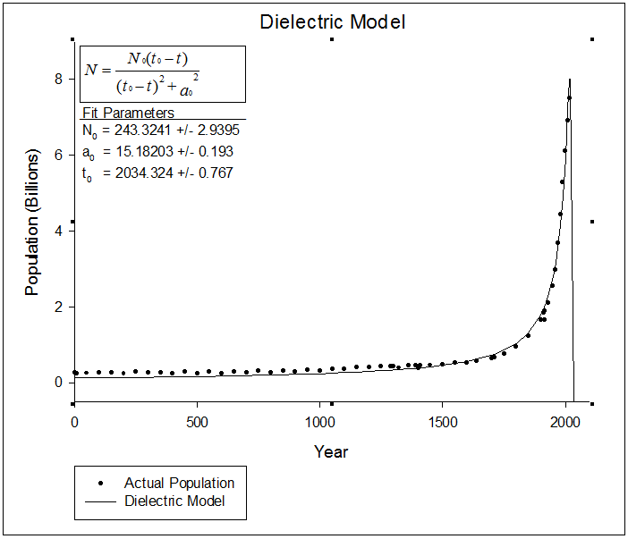
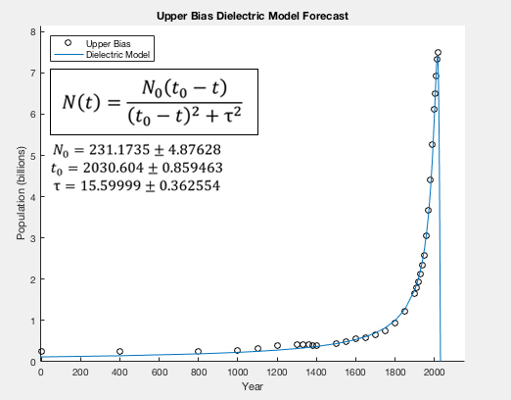
Dielectric Model Forecast

Slide 13
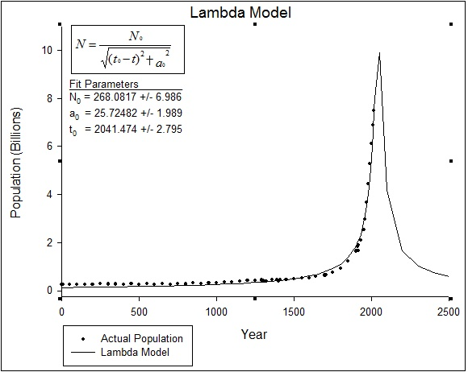
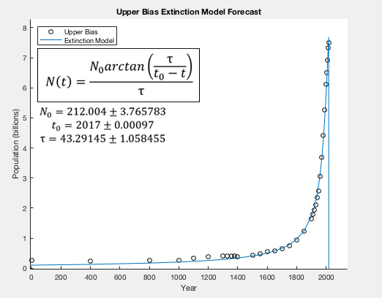
Lambda & Extinction Model Forecast

Slide 14
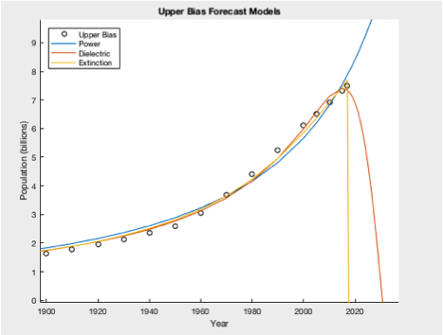
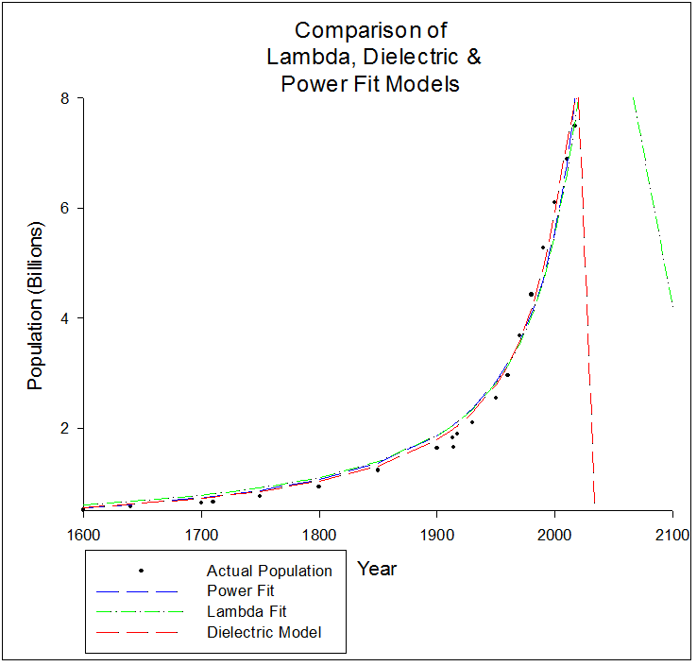
Comparison of the Three Best Models

Slide 15
Parameter Optimization
Using Excel’s Solver tool, the parameters of each model were optimized by a minimization routine on the sum of squares.
Error estimates for each parameter were also calculated.

Slide 16
Model Comparison
After completing the optimization for both a full data set (408 entries) and a recapitulated data set (41 entries), the sum of squares and R-squared values were compared for each of the models.

Slide 17
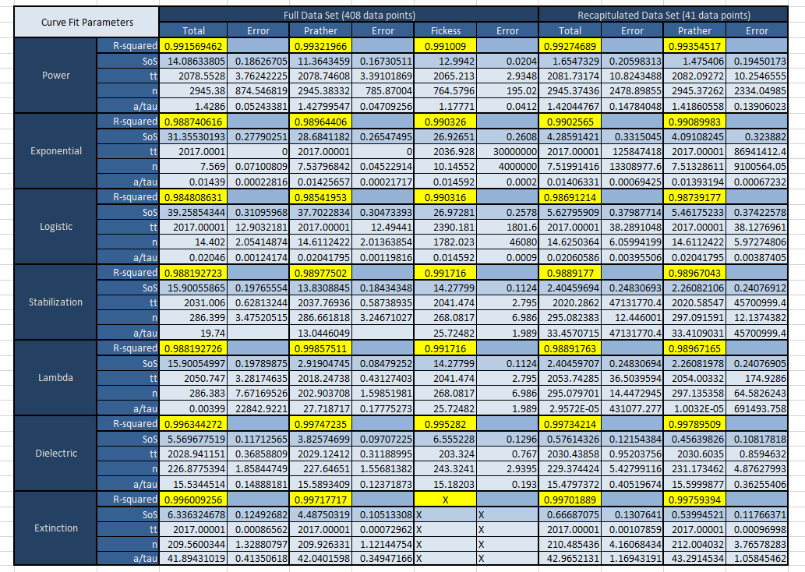
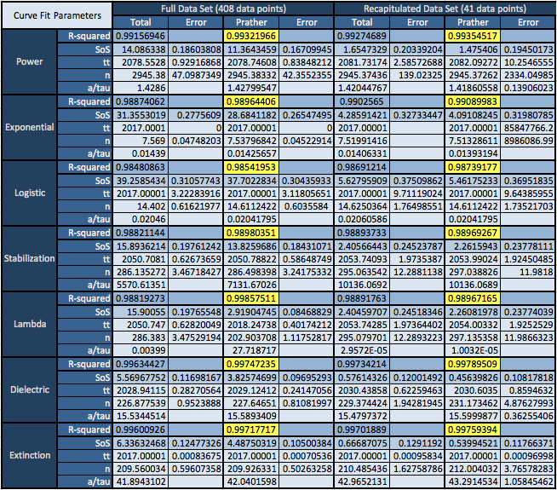
Model Optimization

Slide 18
Optimization Conclusions
Generally, the R-squared value improved for the recapitulated data.
The Power model was a better fit than both the Logistic and Exponential models.
The Dielectric and Extinction models had consistently high R-squared values for both data sets.

Slide 19
Forecasting Conclusions
The power model has a large error associated with one of its parameters, and although having a high R-squared value, it is unlikely that the population will continue increasing indefinitely.
The Extinction model reaches a critical point at the last known input (2017) thus is not likely an accurate prediction.
The Dielectric model remains the most likely description of human population growth.

Slide 20
Timeframe Extrapolation
So if parameter optimization works for the total timeframe does it work well looking at a differential time segments.
Therefore, to test this take only data from time A-B and do the optimization processes done in the prior slides.
So does this work well?

Slide 21
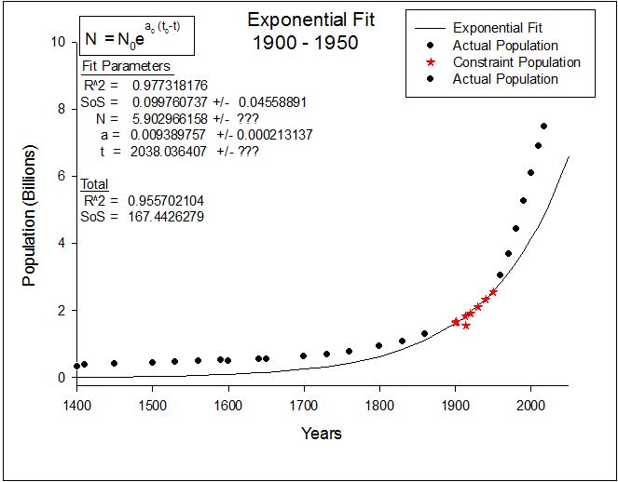
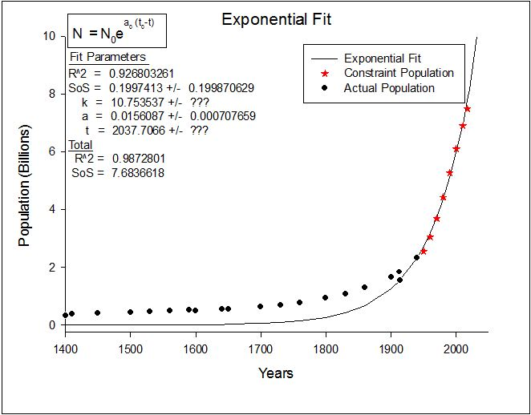
Exponential Model from 1900 – 1950 Vs. 1950 – Present Constraint Models
1900 - 1950
1950 - Present

Slide 22
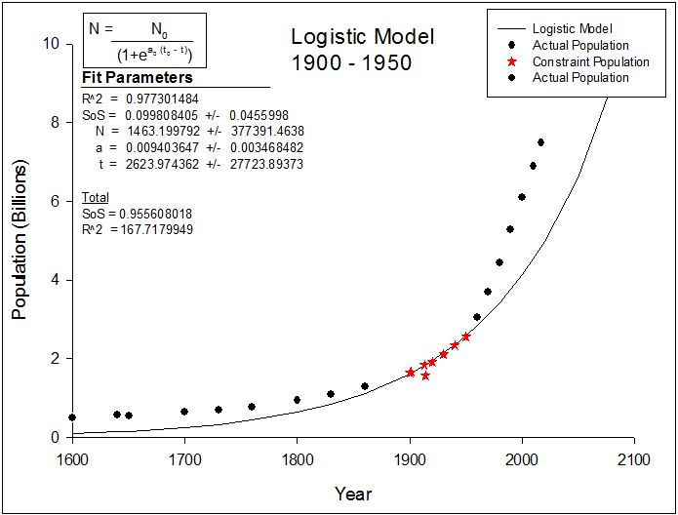
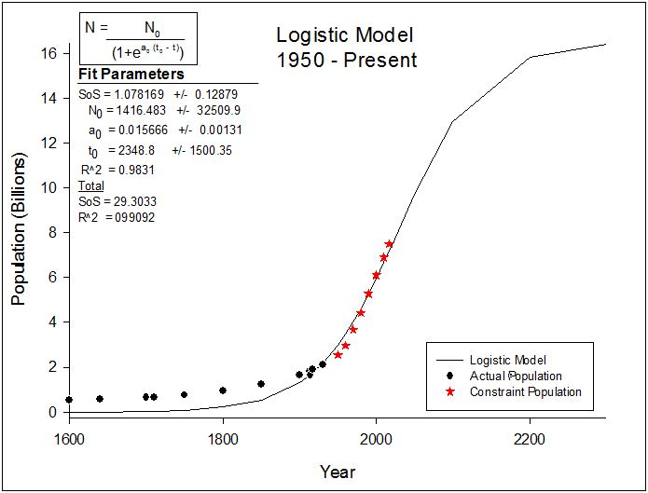
Logistic Model from 1900 – 1950 Vs. 1950 – Present Constraint Models
1900 - 1950
1950 - Present

Slide 23
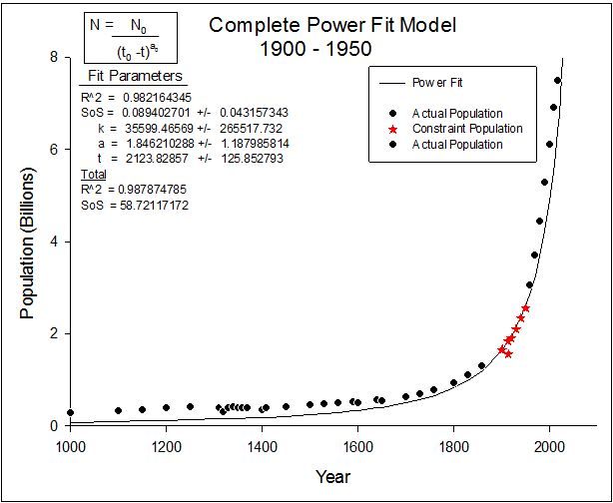
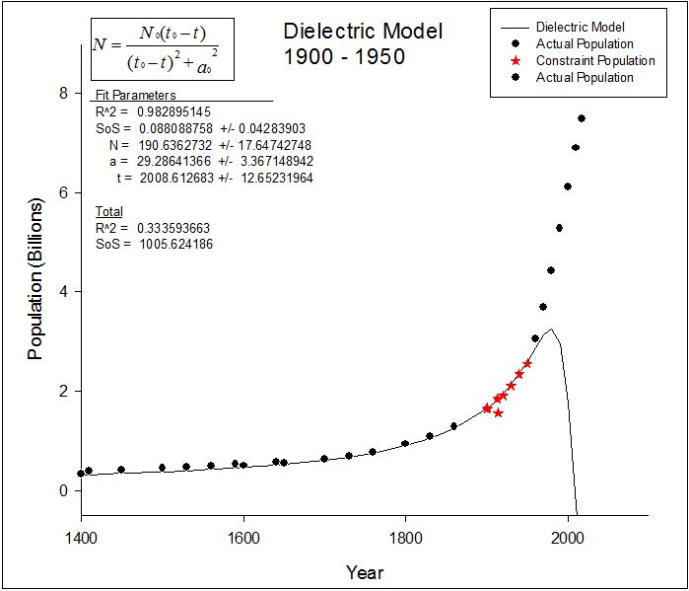
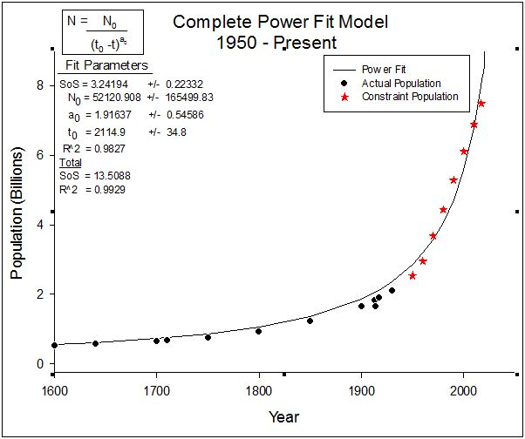
Power Model from 1900 – 1950 Vs. 1950 – Present Constraint Models
1900 - 1950
1950 - Present

Slide 24
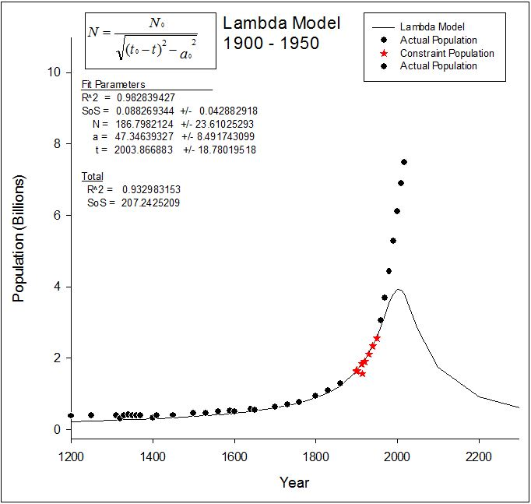
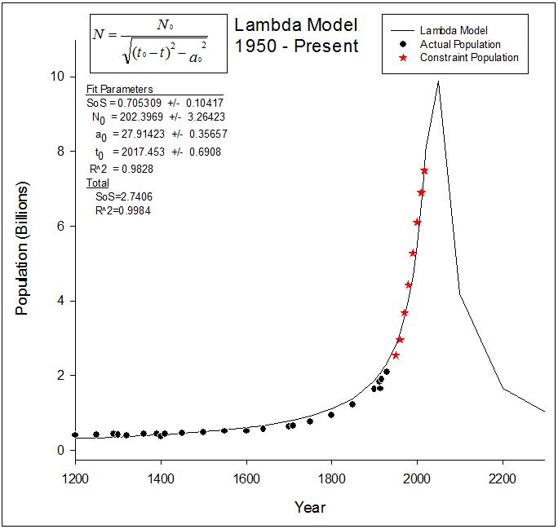
Lambda Model from 1900 – 1950 Vs. 1950 – Present Constraint Models
1900 - 1950
1950 - Present

Slide 25
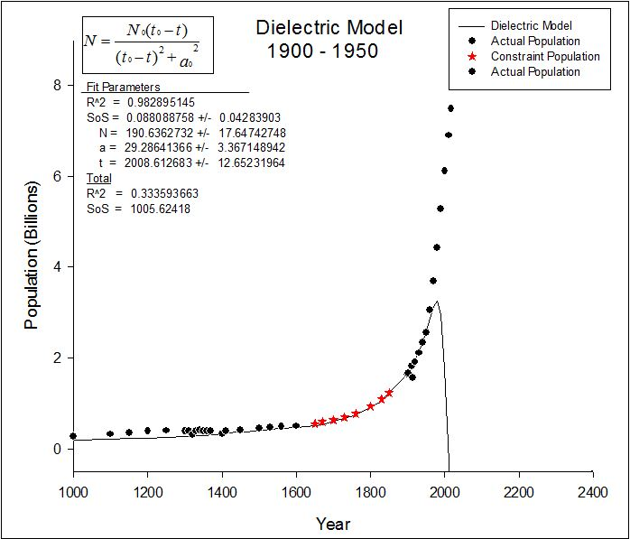
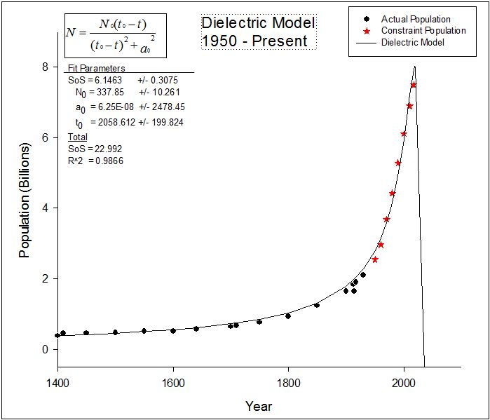
Dielectric Model from 1900 – 1950 Vs. 1950 – Present Constraint Models
1900 - 1950
1950 - Present

Slide 26
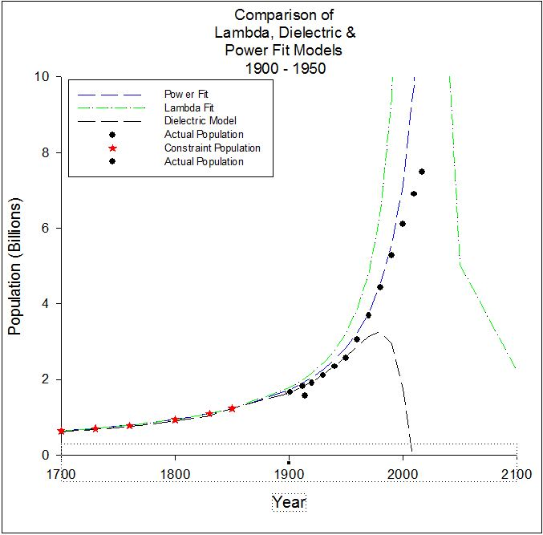
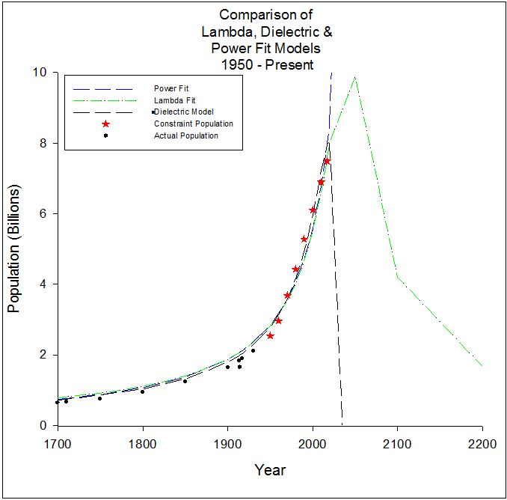
Comparison of the 3 best models from 1900 – 1950 Vs. 1950 – Present Constraint Models
1900 - 1950
1950 - Present

Slide 27
Trend? (Or Lack There Of?)
From the previous slides we saw that there is definitely a downward trend in the optimization for the 1950 – Present Vs. 1900 – 1950 curves.
Does this trend continue to decline if we got to lower dates?
To test this we will look at the 1200 -1300 and 1200 -1500 timeframe optimization.

Slide 28
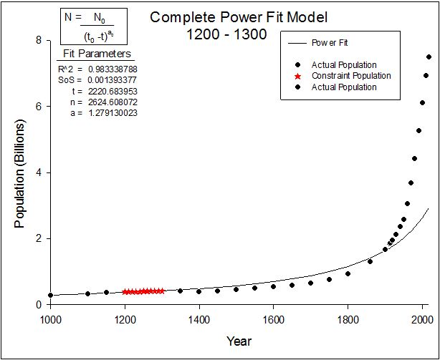
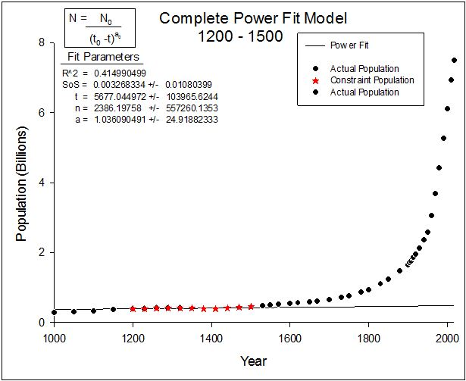
Power Model from 1200 - 1300 Vs. 1200 – 1500 Constraint Models
1200 - 1300
1200 - 1500

Slide 29
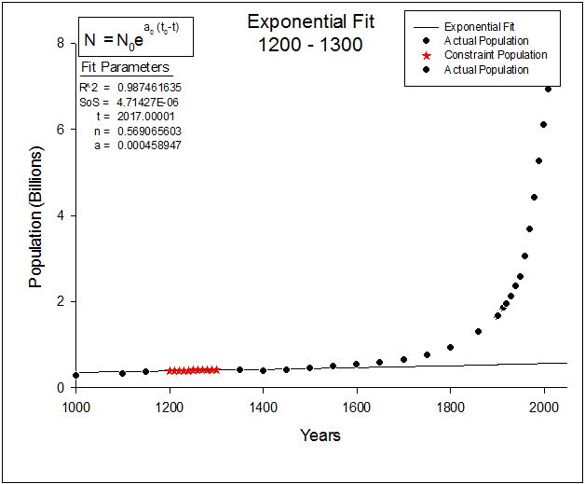
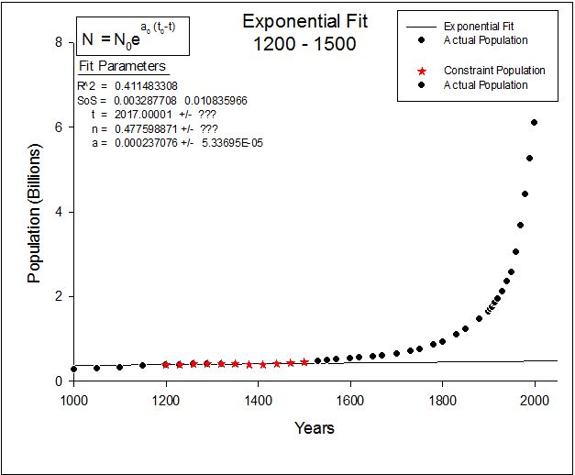
Exponential Model from 1200 – 1300 Vs. 1200 – 1500 Constraint Models
1200 - 1300
1200 - 1500

Slide 30
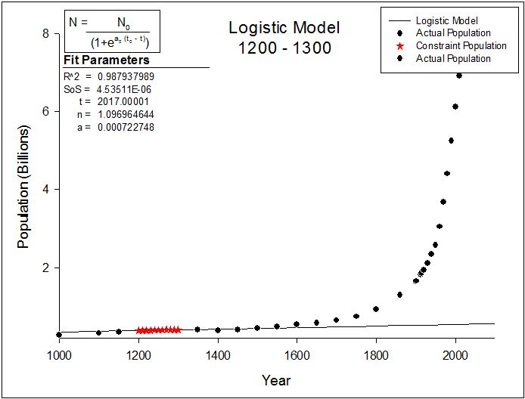
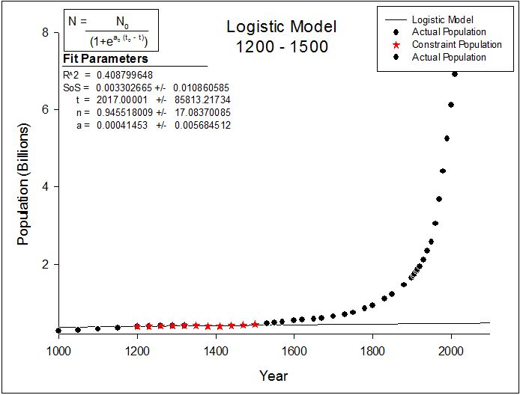
Logistic Model from 1200 – 1300 Vs. 1200 – 1500 Constraint Models
1200- 1300
1200 - 1500

Slide 31
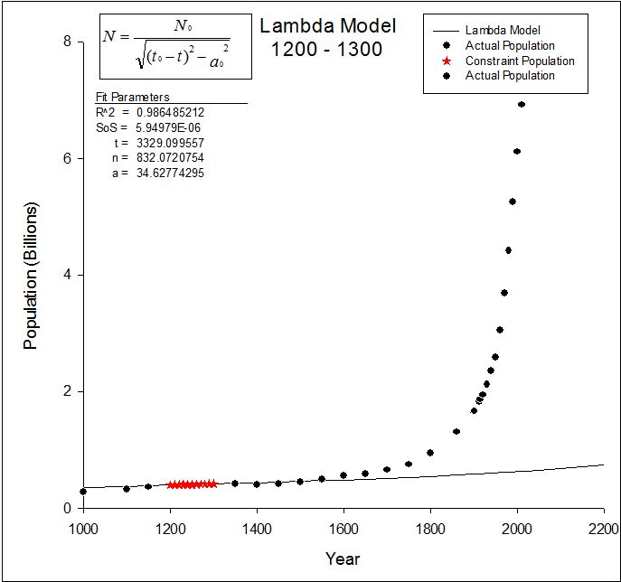
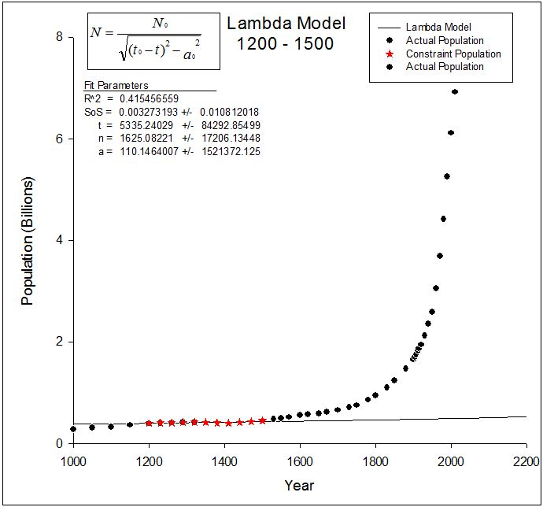
Lambda Model from 1200 – 1300 Vs. 1200 – 1500 Constraint Models
1200 – 1300
1200 - 1500

Slide 32
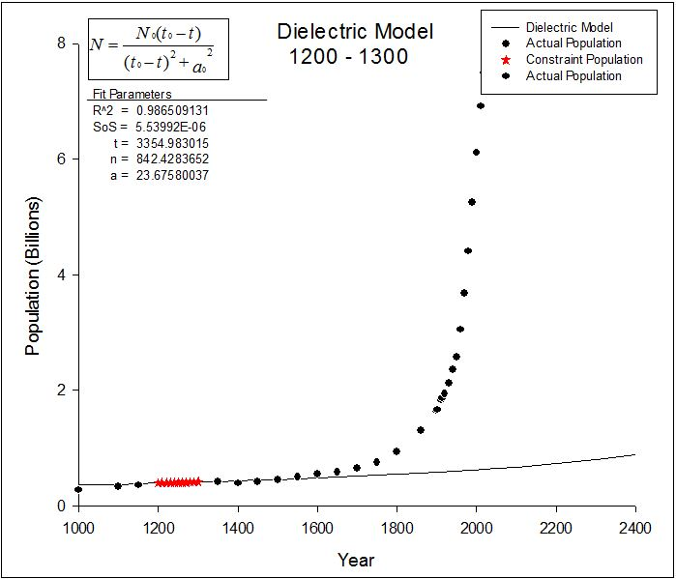
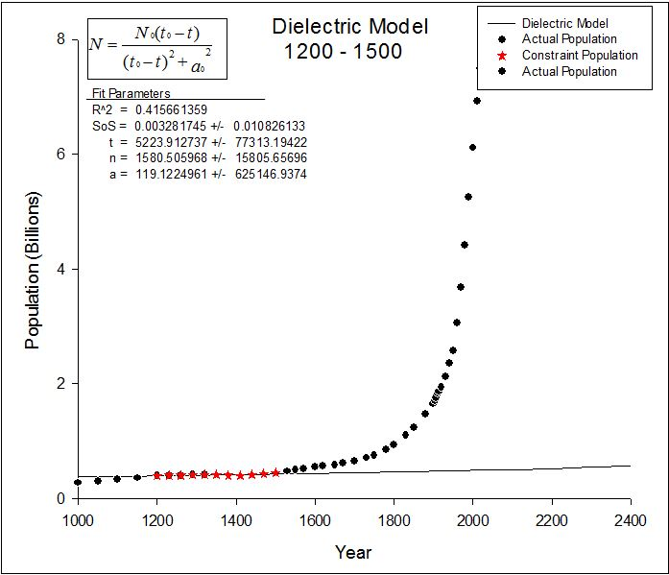
Dielectric Model from 1200 – 1300 Vs. 1200 – 1500 Constraint Models
1200 - 1300
1200 - 1500

Slide 33
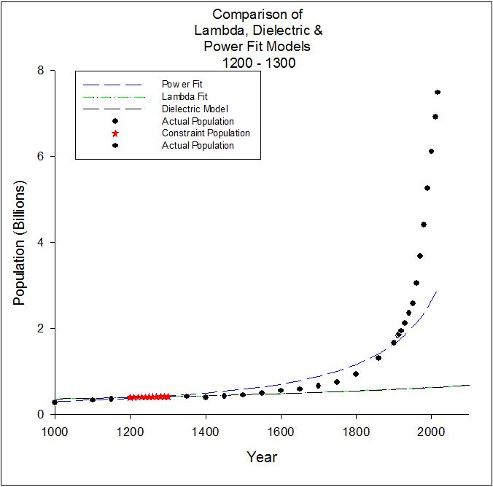
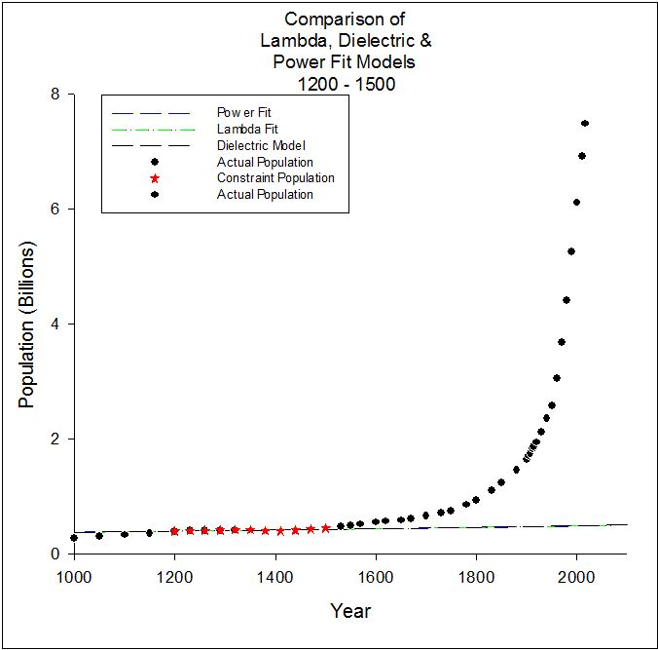
Comparison of the 3 best models from 1200 – 1300 Vs. 1200 – 1500 Constraint Models
1200 - 1300
1200 – 1500

Slide 34
Results of

Slide 35
Timeframe Extrapolation Conclusion
This confirms that this method isn’t a good way to test the curve fitting optimization.
For the most recent time frames there is a good trend in the population which makes that set fit like the total populations set optimization.
For the other sets like the 1200 - 1300 the population growth is either too small or inaccurate give this unexpected parameterization model.

Slide 36
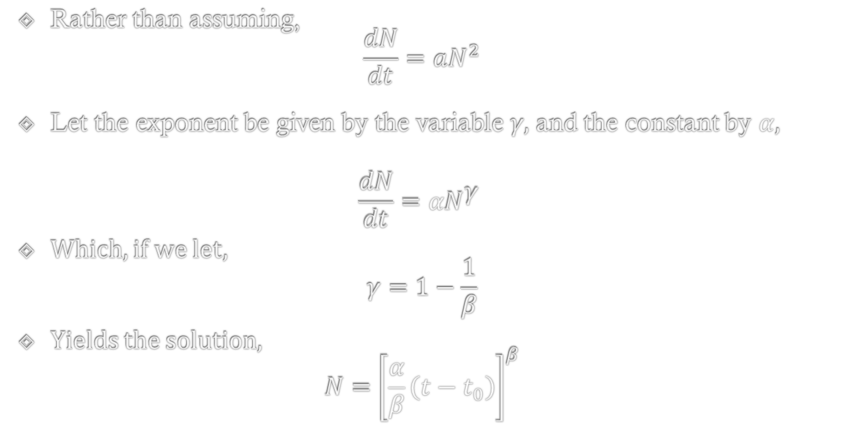
New Power Model
Rather than assuming, $\frac{dN}{dt}=aN^{2}$
Let the exponent be given by the variable 𝛾, and the constant by $α$,
$$\frac{dN}{dt}=αN^{\text{γ} }$$
Which, if we let, $γ=1−\frac{1}{β}$
Yields the solution, $N={\left[\frac{α}{β}\left(t−t_{0}\right)\right]}^{β}$

Slide 37

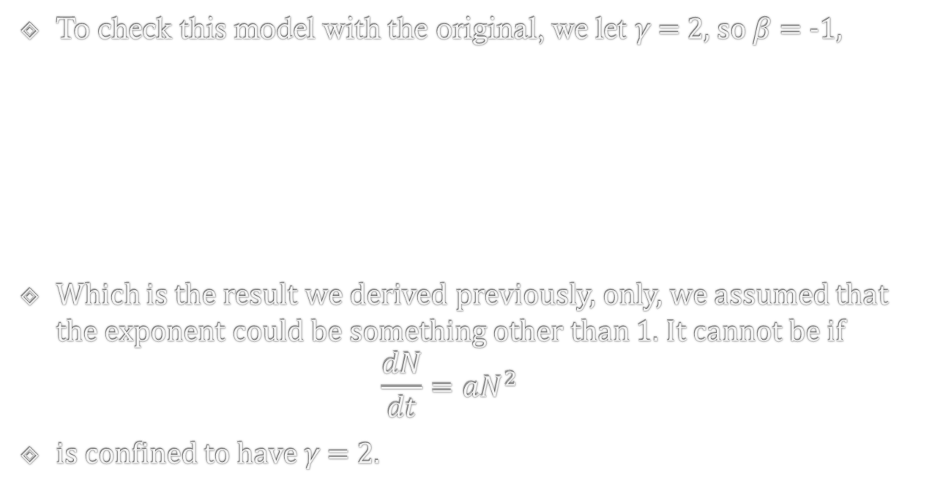


Comparison to Original Power Model
To check this model with the original, we let 𝛾 = 2, so $β$ = -1,
Which is the result we derived previously, only, we assumed that the exponent could be something other than 1. It cannot be if $\frac{dN}{dt}=aN^{2}$
is confined to have 𝛾 = 2.
$$N={\left[\frac{α}{β}\left(t−t_{0}\right)\right]}^{β}$$
$$N={\left[\frac{α}{−1}\left(t−t_{0}\right)\right]}^{−1}$$
$$N=\frac{1}{α\left(t_{0}−t\right)}$$

Slide 38
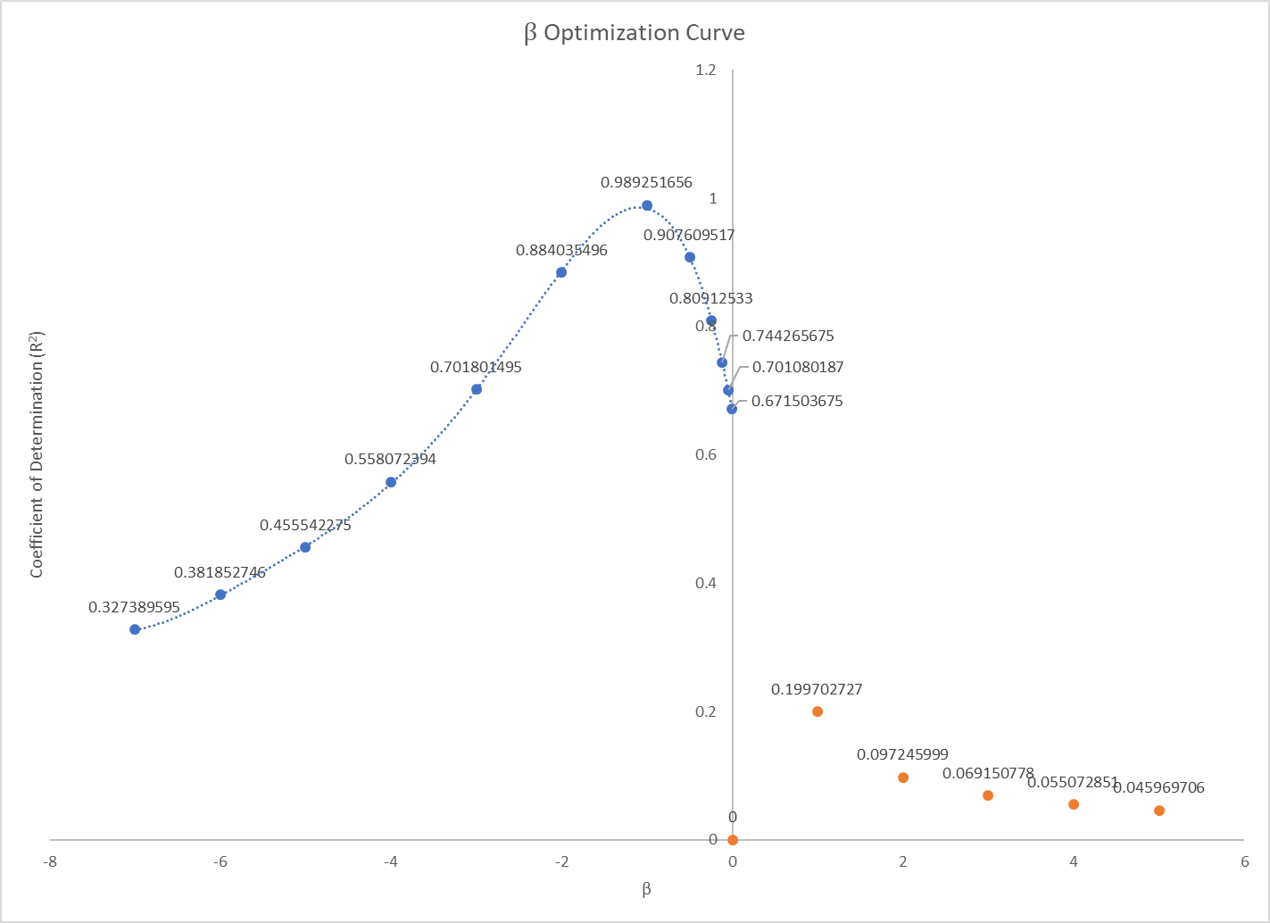
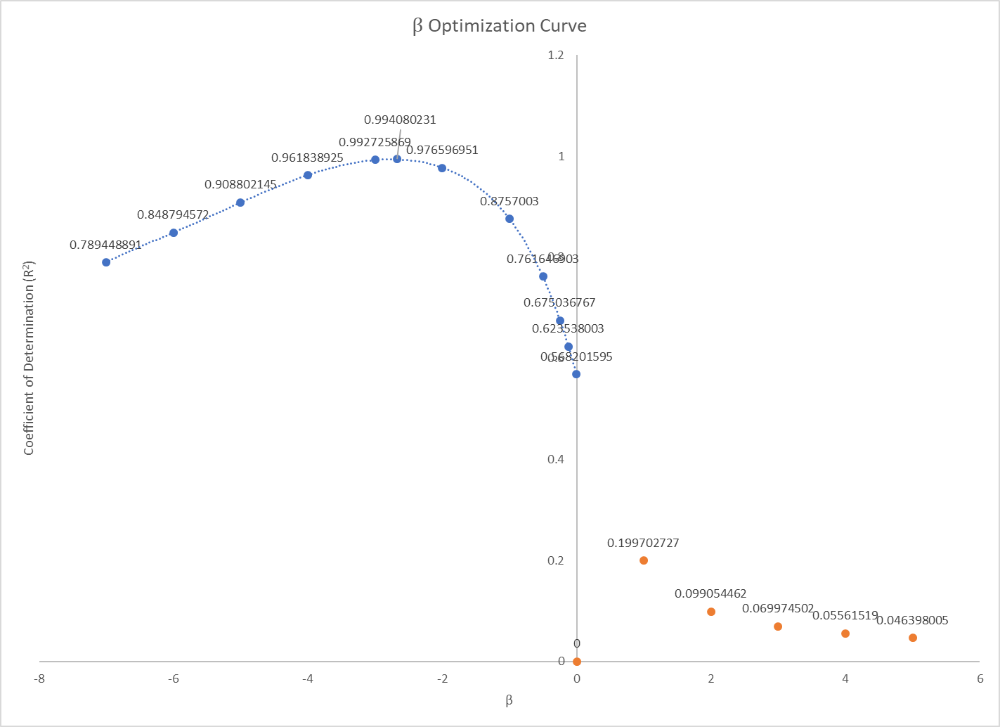
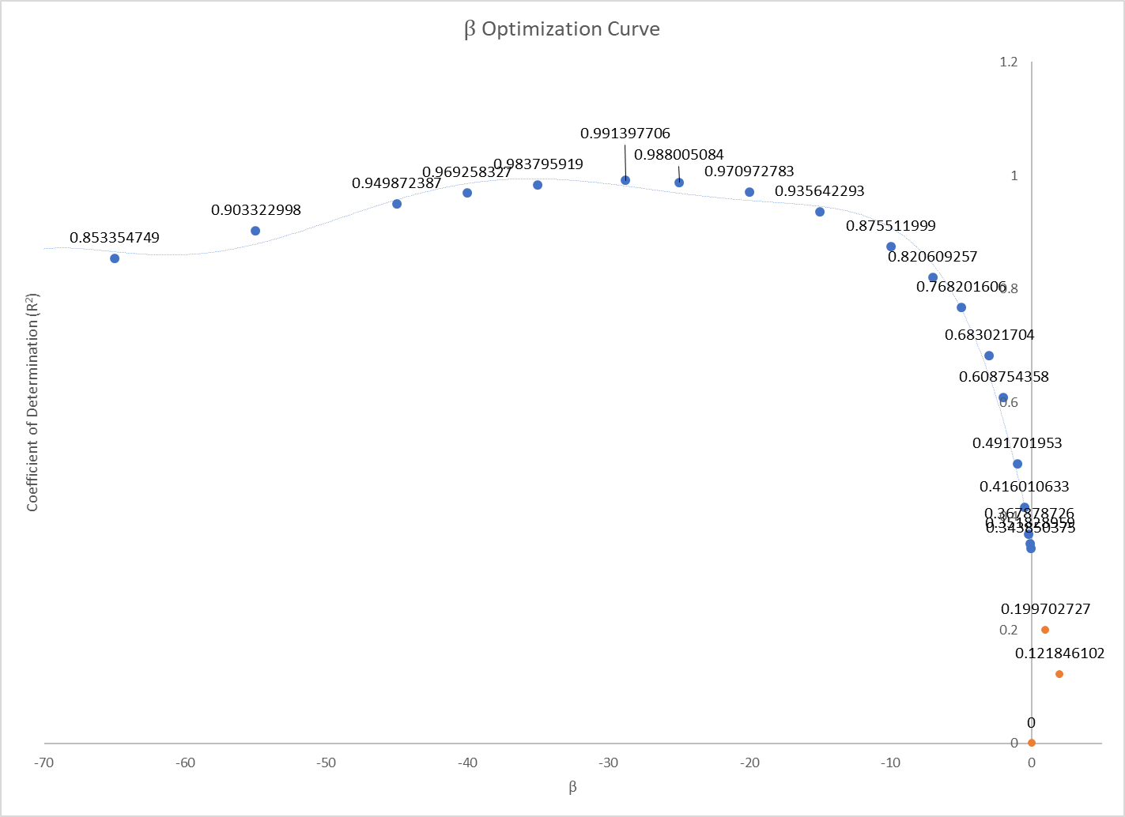
Beta Optimization

Slide 39
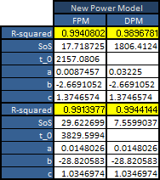
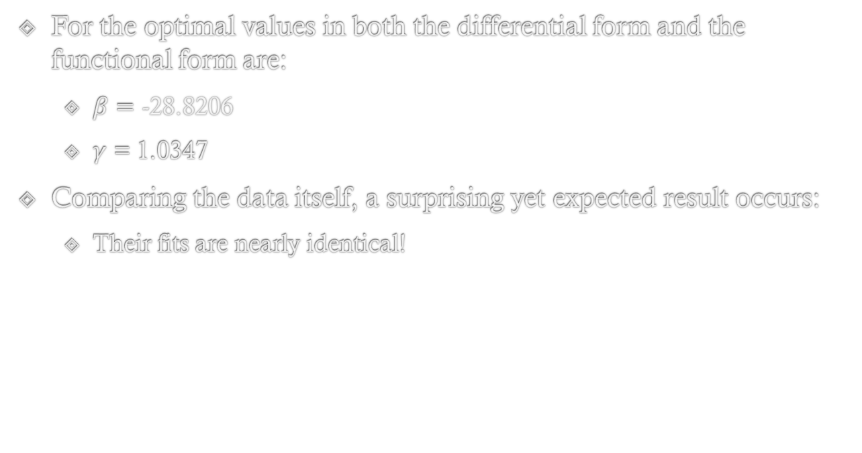
Optimization Results for Beta Model
For the optimal values in both the differential form and the functional form are:
$β=\text{−28.8206}$
$γ$ = 1.0347
Comparing the data itself, a surprising yet expected result occurs:
Their fits are nearly identical!

Slide 40
Creating Population Model Using Law of Mass Action
Chris

Slide 41

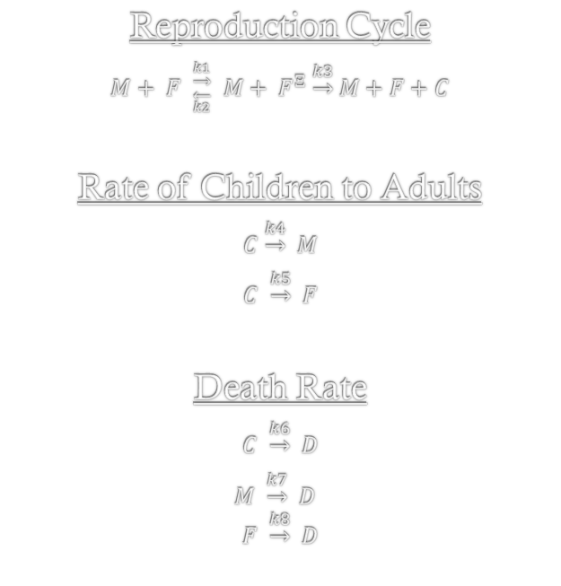
Model of the Reproductive Cycle
Reproduction Cycle
$M+ {F }_{\overset{←}{k2}}^{\underset{→}{k1}} M+ F^{Ξ} \underset{→}{k3} M+F+C$
Rate of Children to Adults
$$C \underset{→}{k4} M$$
$$C \underset{→}{k5} F$$
Death Rate
$$C \underset{→}{k6} D$$
$$M \underset{→}{k7} D$$
$$F \underset{→}{k8} D$$
Gay or Transgender
$$M \underset{→}{k9} TW$$
$$W \underset{→}{k10} TΨ$$
Sterile Population
$$M \underset{→}{k11} Ψ$$
$$F \underset{→}{k12} W$$

Slide 42
Properties of the reactions
Constants | Properties
k1 | Percent of Pregnancies
k2 | Abortions
k3 | Birth Rates
k4 | Children turn into Man
k5 | Children turn into Woman
k6 | Children Death Rate
k7 | Male Death Rate
k8 | Women Death Rate
k9 | Men becoming Gay
k10 | Women Becoming Gay
k11 | Sterile Male
k12 | Sterile Women
To fully model these reactions would be next to impossible.
The reason for this is that each of these constants would be a function that would also change with time.
For simplicity in this reaction we will treat these like constants.

Slide 43


Modeling Differential Equations
The differential equation for the total population will be
$\frac{dP}{dt}=\frac{dF^{Ξ}}{dt}+\frac{dF}{dt}+\frac{dC}{dt}+\frac{dM}{dt}−\frac{dD}{dt}+\frac{dW}{dt}+\frac{dΨ}{dt}$+$\frac{d(TW)}{dt}+\frac{d(TΨ)}{dt}$
Reproductive Cycle Differentials
$\frac{dF^{Ξ}}{dt}=k1∗M∗F−k2∗F^{Ξ}−k3∗F^{Ξ}$
$\frac{dF}{dt}=k3∗F^{Ξ}+k2∗F^{Ξ}−k1∗M∗F$
$\frac{dC}{dt}=k1∗M∗F$
Children Turning to Adults Differentials
$\frac{dM}{dt}=k4∗C$
$\frac{dF}{dt}=k5∗C$
Death Rate Differential
$\frac{dD}{dt}=k6∗C+k7∗M+k8∗F$
Gay Population Differentials
$\frac{d(TW)}{dt}=k9∗M$
$\frac{d(TΨ)}{dt} =k10∗F$
Sterile Population Differentials
$\frac{dW}{dt}=k11∗F$
$\frac{dΨ}{dt} =k12∗M$

Slide 44


Reproductive Differential Equation
Combining this entire set of reactions together, we get the total population reaction to be:
$\frac{dP}{dt}=\frac{dF^{Ξ}}{dt}+\frac{dF}{dt}+\frac{dC}{dt}+\frac{dM}{dt}−\frac{dD}{dt}+\frac{dW}{dt}+\frac{dΨ}{dt}$+$\frac{d(TW)}{dt}+\frac{d(TΨ)}{dt}$
$$\frac{dP}{dt}=\left[\left( k1∗M∗F−k2∗F^{Ξ}−k3∗F^{Ξ}\right)\right]$$
$+\left[\left(k3∗F^{Ξ}+k2∗F^{Ξ}−k1∗M∗F\right)\right]$
$+[(k1∗M∗F)]$
$+\left[\left(k4∗C\right)\right]$
+[$\left(k5∗C\right)$]
$−\left[\left(k6∗C+k7∗M+k8∗F\right)\right]$
$+\left[\left(k10∗F\right)\right]+[\left(k9∗M\right)]$
$+\left[\left(k12∗\right)\right]M+[(k11∗F)$]

Slide 45
Future Work & Summary
Future work
Find a way to model the new differential population model, either by looking at the total population or by evaluating sections of the differential model, like the function for pregnant women.
Find other differential population models of the other previous models.
Do a more thorough investigation of the constraint populations.
Summary
Collect population data
Optimize models
Make forecasts
Compare result
Constraint population extrapolation
Investigate differential forms

Slide 46

Citations
Literature:
1. de Levie, Robert. “Estimating Parameter Precision in Nonlinear Least Squares with Excel's Solver.” ACS Publications, Journal of Chemical Education, 11 Nov. 1999, pubs.acs.org/doi/pdf/10.1021/ed076p1594.
2. Harris, Daniel C. “Nonlinear Least-Squares Curve Fitting with Microsoft Excel Solver.” ACS Publications, Journal of Chemical Education, 1 Jan. 1998, pubs.acs.org/doi/pdf/10.1021/ed075p119
3. Nisbet, I. C. T. “Mathematical Ecology.” BioScience, vol. 20, no. 21, 1970, pp. 1180–1180.
4. Péter Érdi; János Tóth (1989). Mathematical Models of Chemical Reactions: Theory and Applications of Deterministic and Stochastic Models. Manchester University Press. p. 3. ISBN 978-0-7190-2208-1.
5. Pielou, Evelyn C. "An introduction to mathematical ecology." An introduction to mathematical ecology. (1969).
6. Nonlinear Saturation Model of World Population Growth, Reza Mofid and Weldon J. Wilson 2010
7. Nonlinear Models of World Population Growth, Alan Harris and Weldon J. Wilson 2009
8. A Predator-Prey Model of World Population Growth; Weldon J. Wilson 2006
Data Sources:
www.aae.wisc.edu/aae641/Notes/World_Population.docx
https://www.census.gov/population/international/data/worldpop/table_history.php
http://www.scottmanning.com/archives/World%20Population%20Estimates%20Interpolated%20and%20Averaged.pdf
http://www.worldometers.info/world-population/world-population-by-year/
https://www.un.org/esa/population/publications/sixbillion/sixbilpart1.pdf
https://esa.un.org/unpd/wpp/DataQuery/
https://www.census.gov/population/international/data/worldpop/table_population.php
http://data.worldbank.org/indicator/SP.POP.TOTL?end=2015&start=2015&view=map&year=1960

Slide 47

Acknowledgements
Dr. Weldon Wilson
STLR Grant
RCSA Grant

